Slide 1
Two-way repeated measures ANOVA—Amputee data

Slide 2
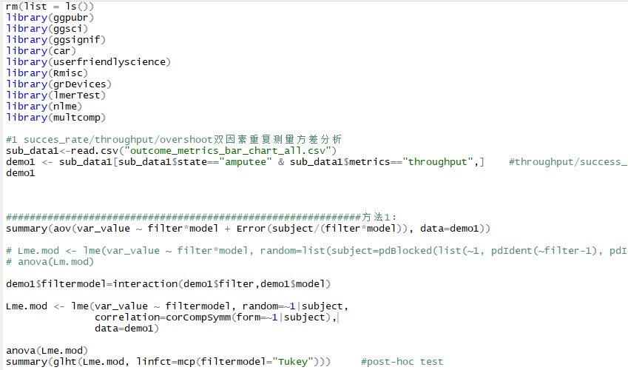
var_value ~ filter*model + Error(subject/(filter*model))

Slide 3
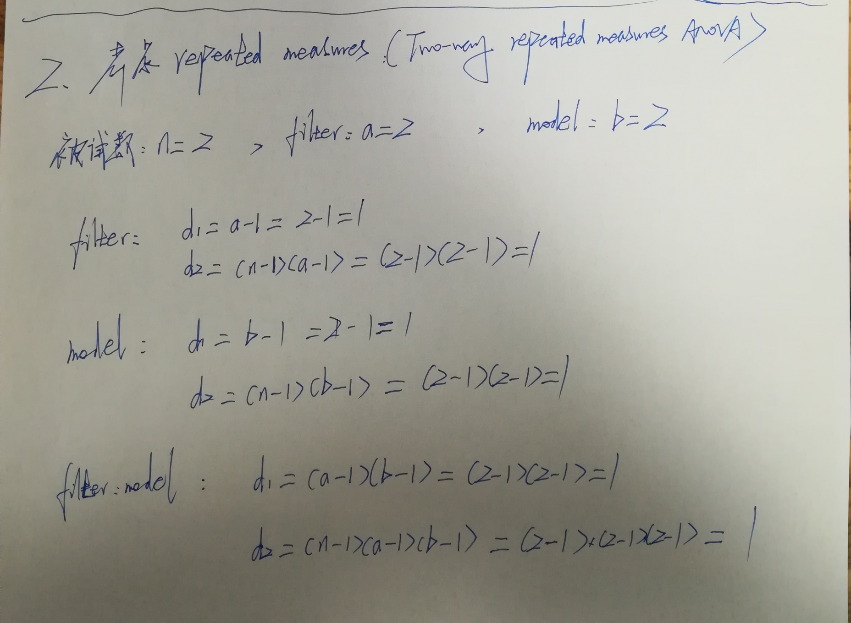
自由度计算

Slide 4
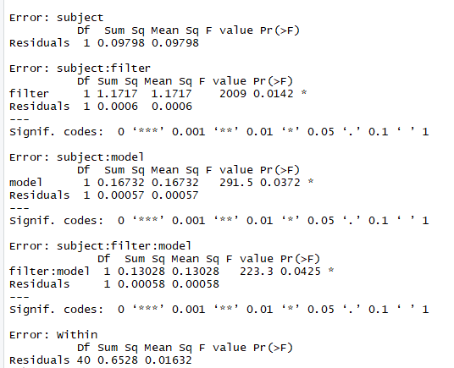
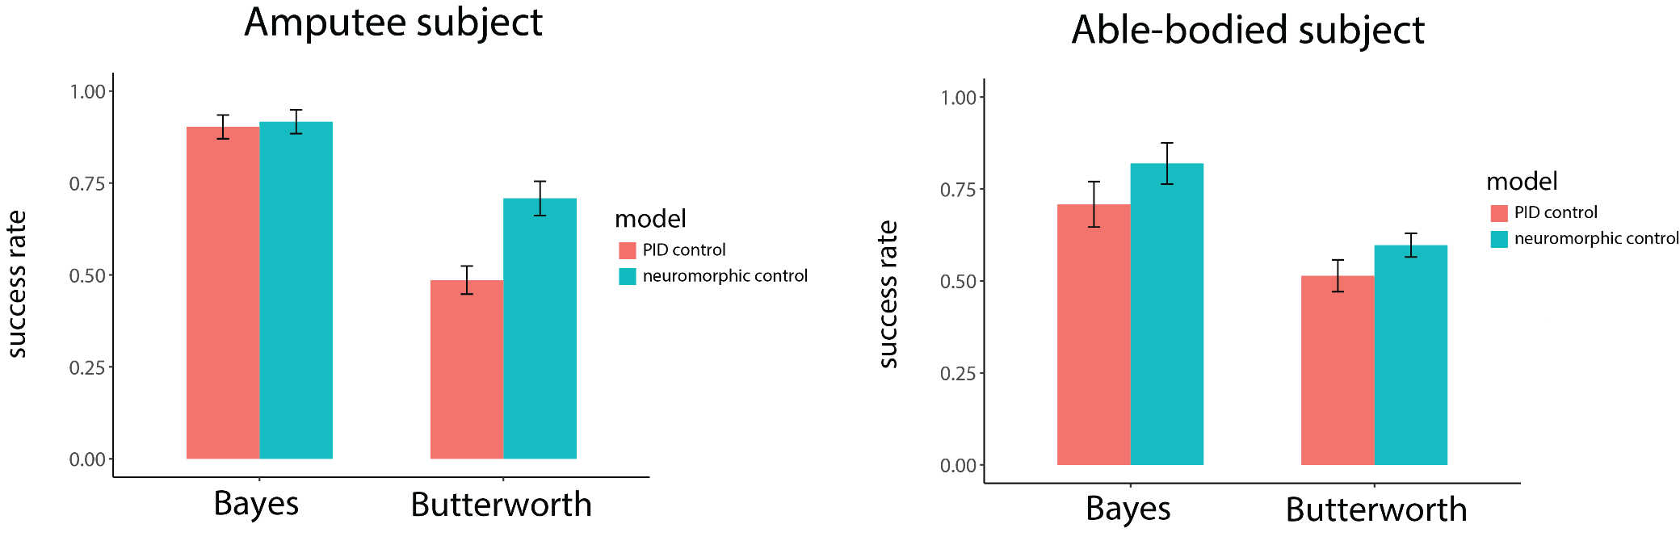
Success rate——Amputee
filter—F(1,1)=2009, P<0.05
model—(1,1)=291.5, P<0.05
filter: model —F(1,1)=223.3, P<0.05

Slide 5
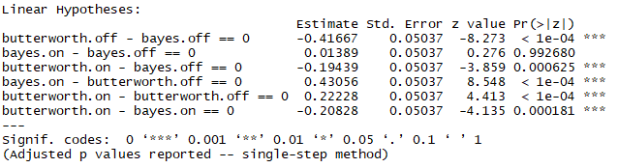
SR — post hoc test

Slide 6
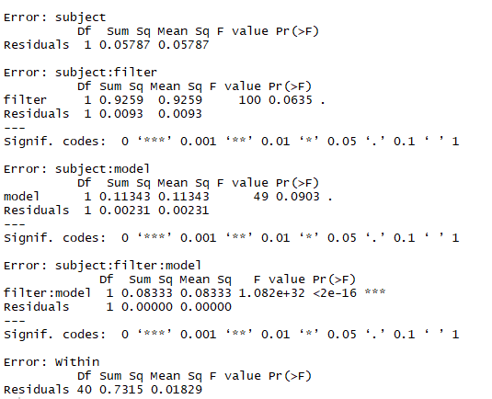
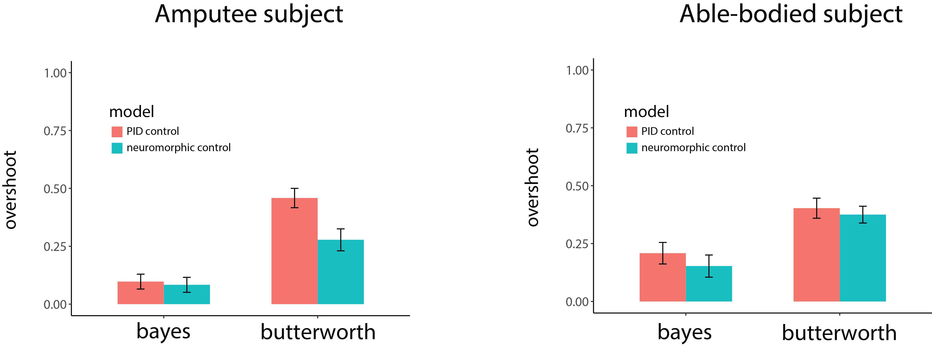
Overshoot ——Amputee
filter—F(1,1)=100, P=0.0635
model—F(1,1)=49, P=0.0903
filter: model —F(1,1)=+∞, P<0.001
Bayes Butterworth

Slide 7
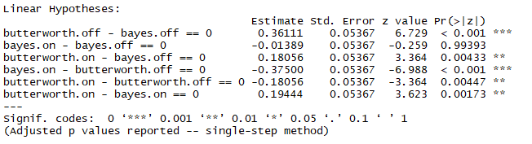
OS — post hoc test
Bayes Butterworth

Slide 8
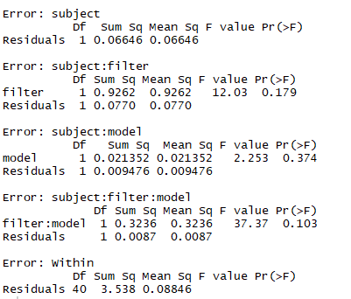
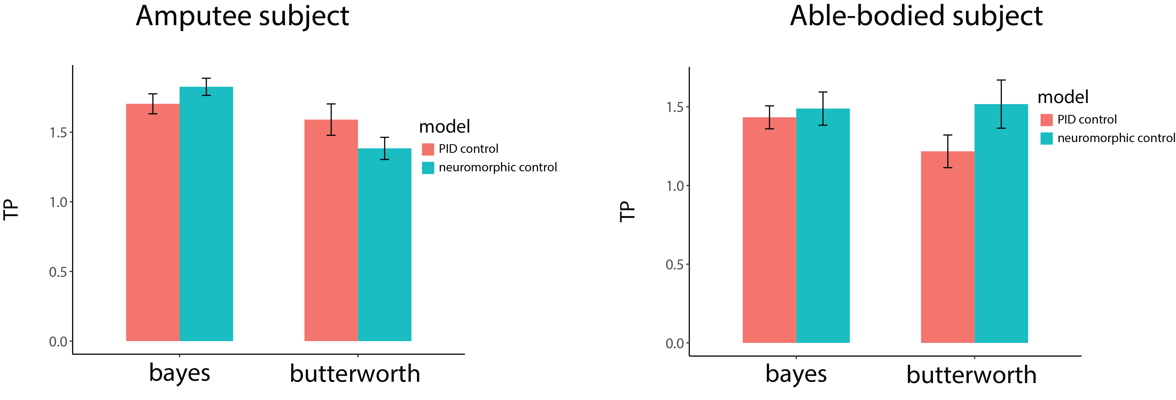
Throughput ——Amputee
filter—F(1,1)=12.03, P<0.179
mode—F(1,1)=2.253, P=0.374
filter: model —F(1,1)=37.37, P=0.103
Bayes Butterworth

Slide 9
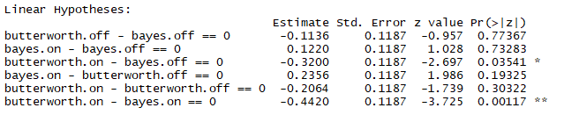
TP — post hoc test
Bayes Butterworth

Slide 10
Two-way repeated measures ANOVA—Able-bodied data

Slide 11
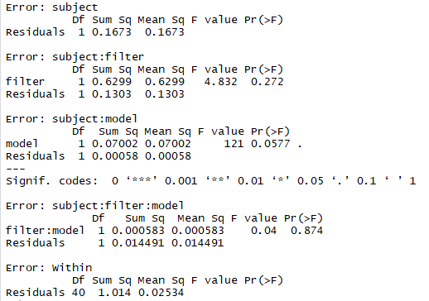
Success rate——able-bodied subject
利用aov
filter— F(1,1)=4.832, P=0.272
model—F(1,1)=121, P=0.0577
filter: model —F(1,1)=0.04, P=0.874

Slide 12
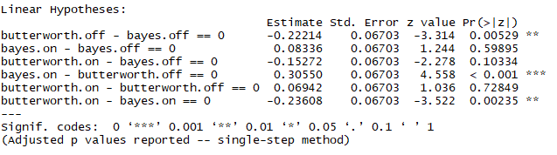
SR — post hoc test

Slide 13
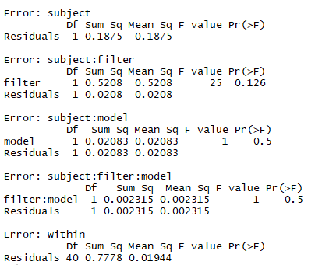
Overshoot ——able-bodied subject
filter—F(1,1)=25, P=0.126
model—F(1,1)=1, P=0.5
filter: model —F(1,1)=1, P=0.5
Bayes Butterworth

Slide 14
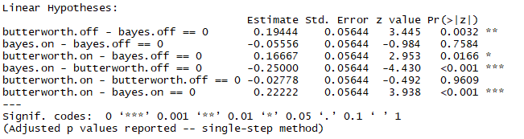
OS — post hoc test
Bayes Butterworth

Slide 15
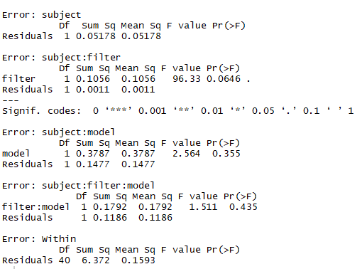
Throughput ——able-bodied subject
filter: F(1,1)=96.33, P=0.0646
model: F(1,1)=2.564, P=0.355
filter: model —F(1,1)=1.511, P=0.435
Bayes Butterworth

Slide 16
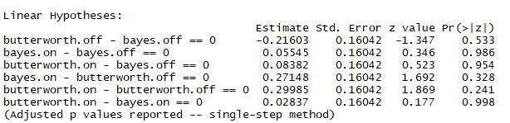
TP — post hoc test
Bayes Butterworth

